Slide 1

Behind the Merge: Lessons from two years
as a student open-source contributor
Shubham Singh, Obmondo

Slide 2

Hey!
This is Shubham
SRE Intern @Obmondo
Computer Science Student
LFX’24 graduated mentee
Certified Kubernetes Administrator
Org member at KubeEdge
GitHub: @1shubham7
Twitter: @1shubham7

Slide 3
01
KubeEdge

Slide 4

















KubeEdge
Flexible quality inspection
OCR
Facial Recognition
Behavior Analysis
…
KubeEdge - EdgeCore
KubeEdge - CloudCore
Device
Management
Edged
Meta Manager
Cloud - Edge
Coordination
CloudHub
DeviceController
EdgeController
EventBus
DeviceTwin
EdgeHub
Data Access
The first Cloud Native Edge Cloud Computing OSS Project
Open Governance, connecting Cloud Native and Edge Computing Ecosystem
7,600+ stars, 2,100+ forks on GitHub
1500+ contributors (350+ code committers) from 100+ organizations
Edge Computing scenarios oriented, designed for edge-cloud collaboration.
Consistent experience of Applications, Resources, Data, Devices, etc. between cloud & edge

Slide 5
02
Project
Background
What is Edge Computing

Slide 6






Edge Computing
Home
ACC
AGG
Metro
Enterprise
~50km
1~5ms
50~200km
5~10ms
eNodeB
>200km
>20ms
Nearside Edge
City Edge
Regional Edge
Cloud
EDGE
MEC
MEC
MEC
Cloud
Services
Cloud Services
Millions
Hundreds-Thousands
Tens- Hundreds
tens
Typical Apps
V2X, AR/VR, AI
AI Inference
vCDN, AR/VR
Rendering, Video transcoding
AI Training , Big Data
AI Training/Inferencing, Video transcoding
*Bringing the workloads close to device

Slide 7
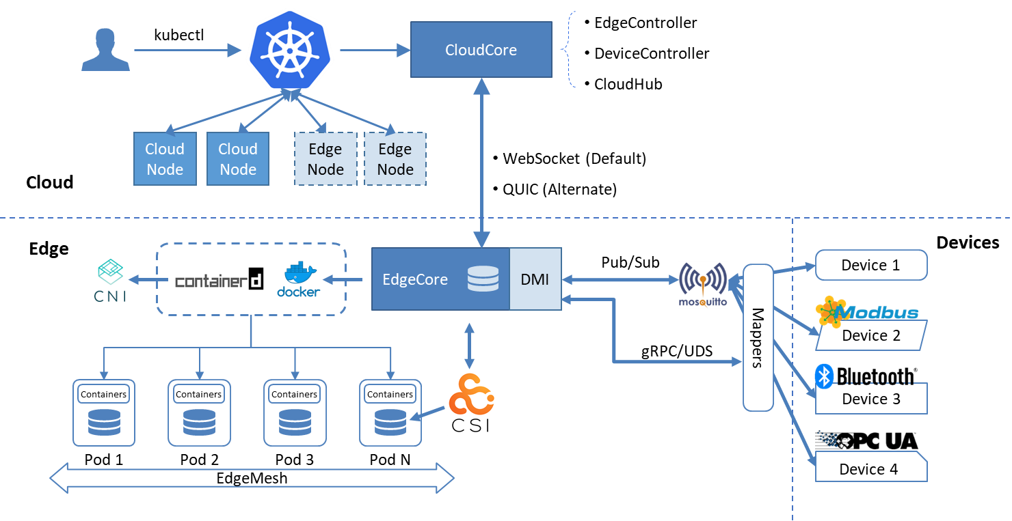
Architecture
Seamless Cloud-Edge Coordination
Edge Autonomy
Low Resource Readiness
Simplified Device Communication
Open Ecosystem

Slide 8
03
Issue
KubeEdge test cases enhancement

Slide 9
Improve Test Converage of KubeEdge
E2E Tests
Integration Tests
Unit Tests
These are broad tests of overall system behavior and coherence.
These tests cover interactions of package components or interactions between KubeEdge components and Kubernetes control plane components like API server.
These confirm that a particular function behaves as intended. Unit test source code can be found adjacent to the corresponding source code within a given package.

Slide 10
My technical learnings
Testify is the best
Worked on Ginkgo and Gomega
Interacting with the Kubernetes API
Read a lot of code
Understood how CLI tools are created.

Slide 11

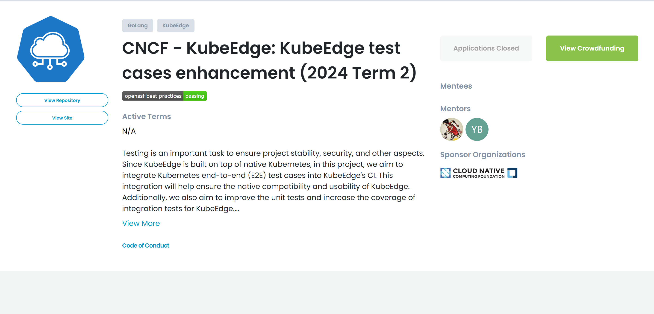

Slide 12
04
My Journey and the lessons I learned

Slide 13
Lessons I learned
01
Just Jump in!
It's okay not to know everything, no one does. Just jump in and learn on the go!
02
Communicate
Join the Slack communities, Weekly meetings and ask. You can get your doubts cleared and understand the maintainers expectations.

Slide 14
Lessons I learned
03
Abstraction to Understanding
You start with a problem statement you don’t understand fully, break it into smaller problems and solve one at a time.
04
Try before asking
You will have limited time with the project maintainers – so make sure to do your research before you ask a question. It may just be a Google away.

Slide 15
Lessons I learned
05
The journey is not a straight line
You start with a problem statement you don’t understand fully, break it into smaller problems and solve one at a time.
06
Always say yes to opportunities
Just say “yes” and then figure out how to do it. You will get much more opportunities if you just say “yes” to challenges.

Slide 16
Thanks!

Slide 17
05
Bonus Slides: More about KubeEdge

Slide 18
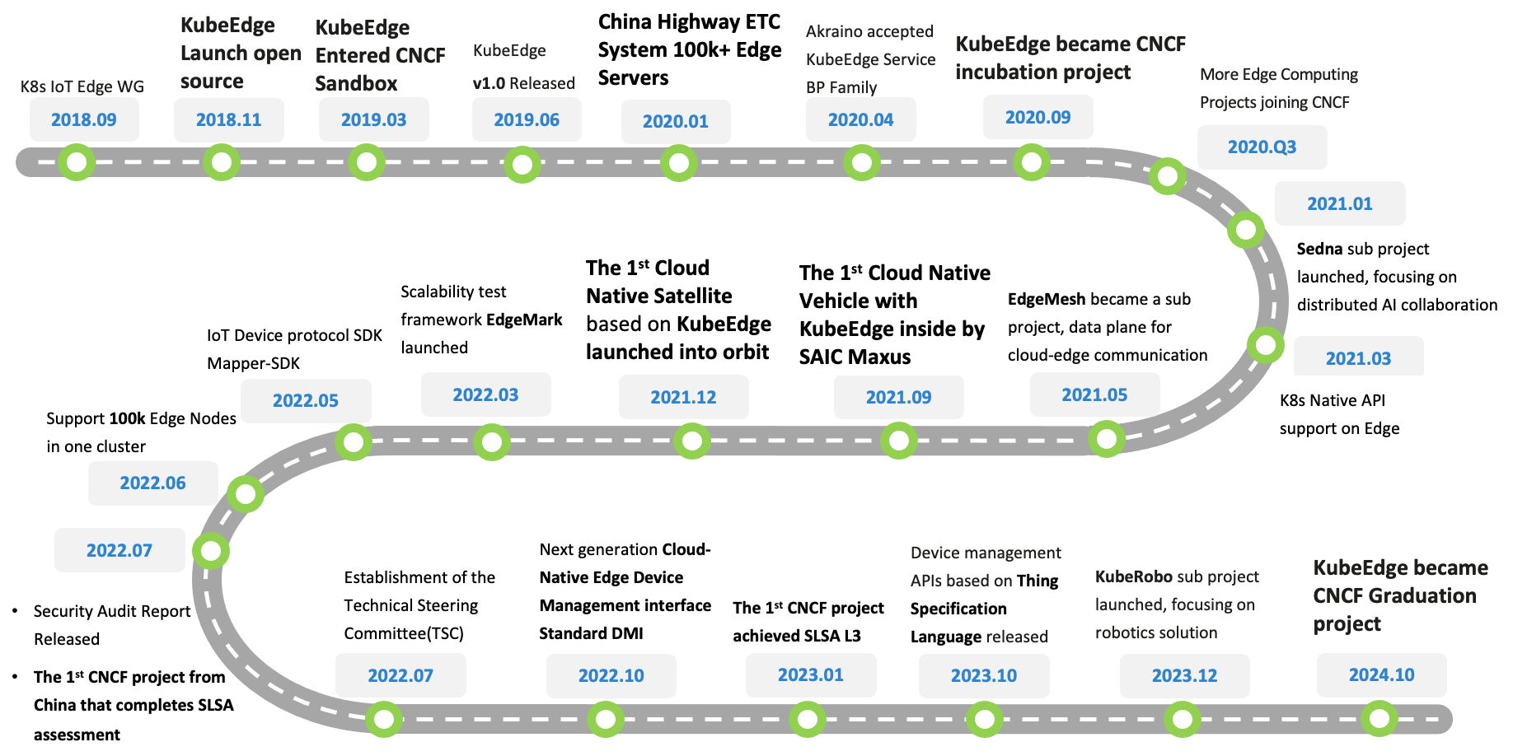
Project Journey

Slide 19
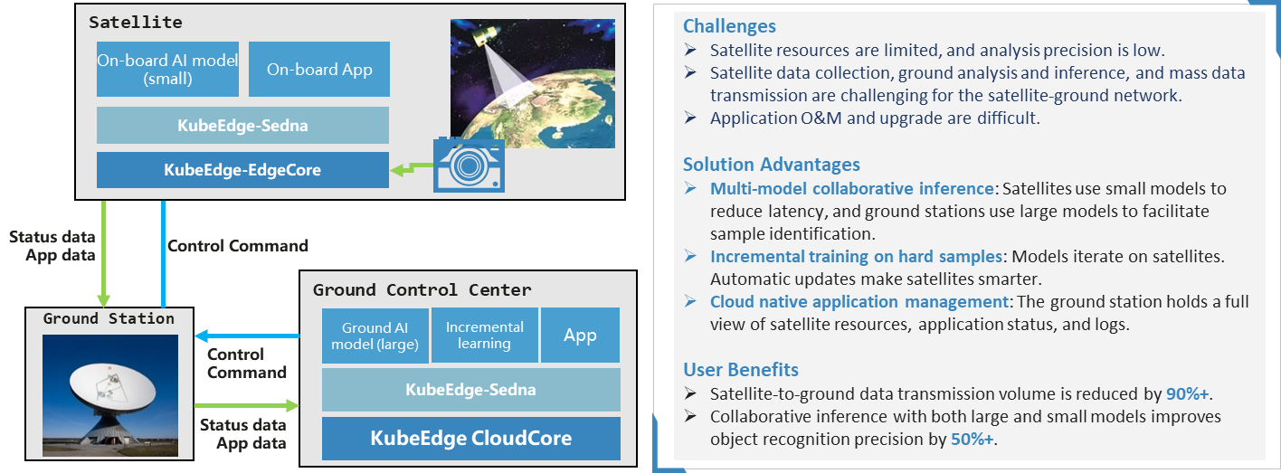
Low Earth Orbit Satellite

Slide 20
Thanks!

